Slide 1
Indian Sign Language Recognition
Using Deep Learning
Project By:
19IT031-Aman Desai
19IT032-Mansi Desai
19IT037-Hardik Gandhi

Slide 2
What is Sign language ?
A language used especially by people who cannot hear or speak, using the hands to make signs instead of spoken words.
There are many different type of sign languages. Few of them are :
1. American Sign language (ASL)
2. British , Australian and New zealand sign language(BANZSL)
3. Indian Sign language (ISL)

Slide 3
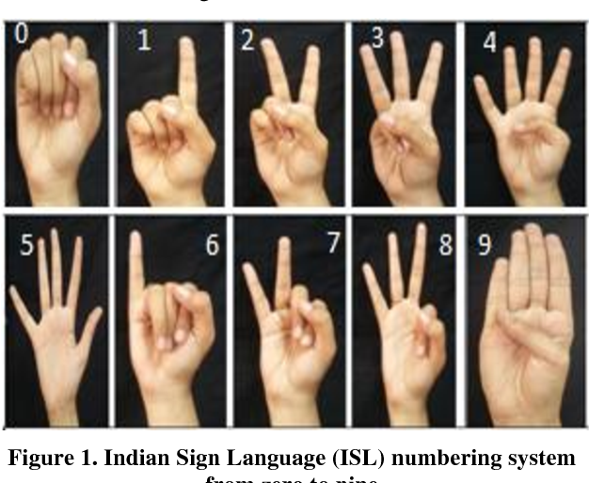
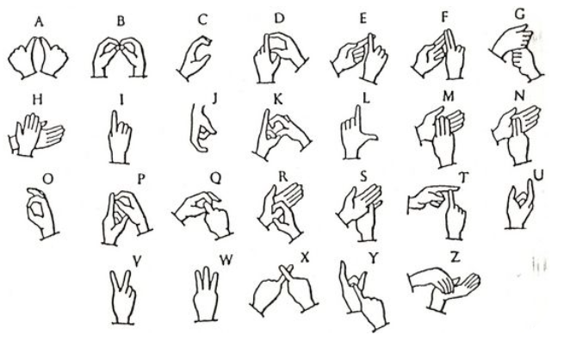
Indian Sign Languauge

Slide 4
Introduction
Sign Language is specifically focused towards Deaf and Dumb People.
It’s the language they use to communicate with each other and others who know SL(Sign Language).
Sign Languages are gestural languages which contain symbolic encoded message for communication without speech channel.
Indian Sign Languauge (ISL) is a language used by Indian deaf and dumb community
More than one million deaf adults and around half million deaf children use ISL as a mode of communication.

Slide 5
Introduction (Cont.)
ASL is the one in which most research has been done and there hasn’t been significant amount of research done on ISL.
There are many different ways to solve this problem like by using Gloves that can sense the gesture, or by Microsoft Kinect Sensor but both of them are high end and expensive.
Our aim : To solve this with the help of Computer vision combined with Deep Learning

Slide 6
Tools & Tech.
Open CV
Deep Learning
Convolutional Neural Network

Slide 7

Open CV
Open CV is the Open source Computer vision Library.
It enables the computer to understand and identify the content of image or video frame in the same way that humans do.

Slide 8
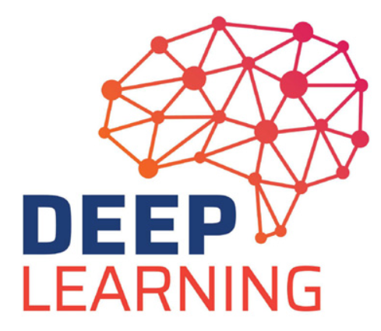
Deep Learning
Deep Learning is the Subset of Machine Learning that teaches the computer to do what comes naturally to humans by processing data and creating patterns for use in decision making.
Deep Learning consist of Neural Networks that are used to mimic the human brain.
Convolution Neural Network is used to visualize the data from images and videos.

Slide 9


Language & Packages
Language : Python
Packages
1. OpenCV
2. Tensorflow
3. OS

Slide 10
Project Flow
Data Collection
Image Pre-processing
Applying CNN
Tunning parameters
Deploying Model
Model Evaluation
Model Training

Slide 11
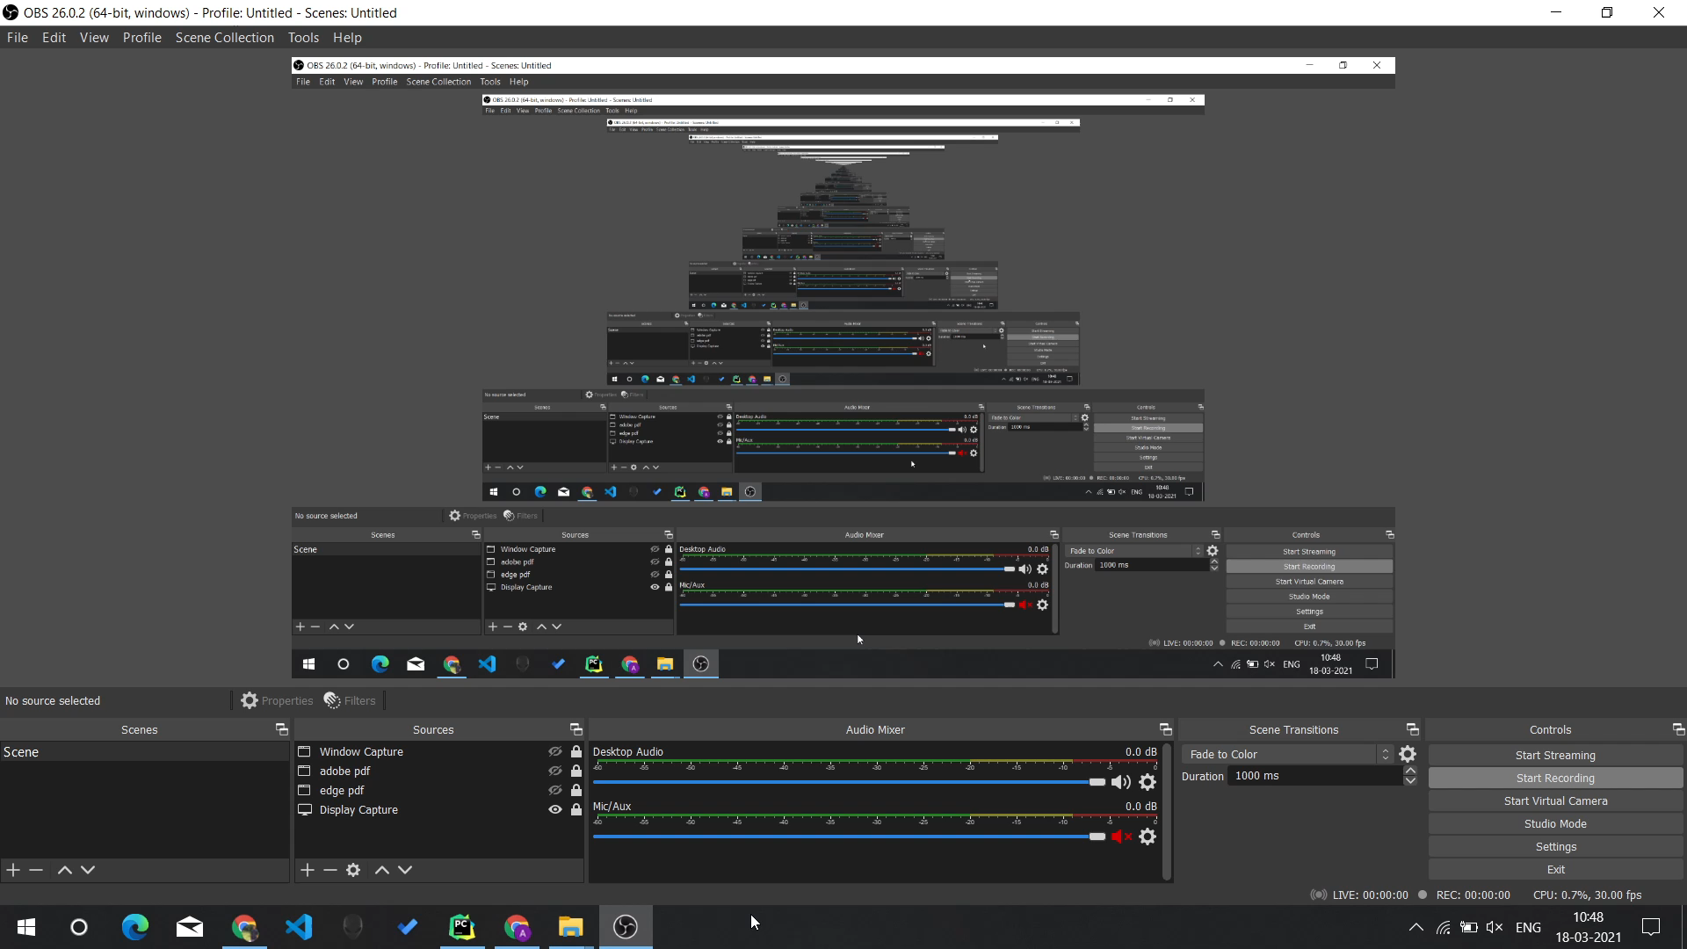
Video of Implementation

Slide 12
Conclusion & Future Work
At present the training is done on smaller dataset and thus the model is not that accurate, We assume that training the model on larger dataset and applying additional layers will increase accuracy.
As our model is trained on digit’s data (Numbers), our goal is to train on alphabetical data.
As this dataset is custom made, the number of images are not enough to gain more accuracy so we will try to increase number of images as well as accuracy at different angles.

